Slide 1
Metrics for Evaluating Classifier Performance
Terminologies:
Positive Tuples: tuples of the main class of interest
Negative Tuples: All other tuples.
(e.g. Given two classes , the positive tuples may be buys computer = yes while the negative tuples are buys computer = no.)
True Positives(TP):These refer to the positive tuples that were correctly labeled by the classifier.
True Negatives(TN): These are the negative tuples that were correctly labeled by the classifier.
False Positives(FP):These are the negative tuples that were incorrectly labeled as positive
(e.g., tuples of class buys computer = no for which the classifier predicted buys computer = yes).
False Negatives(FN):These are the positive tuples that were mislabeled as negative (e.g., tuples of class buys computer = yes for which the classifier predicted buys computer = no).
These terms are summarized in a Confusion Matrix
‹#›

Slide 2
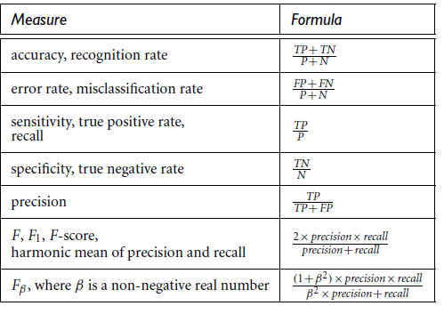
The Classifier Evaluation Measures

Slide 3
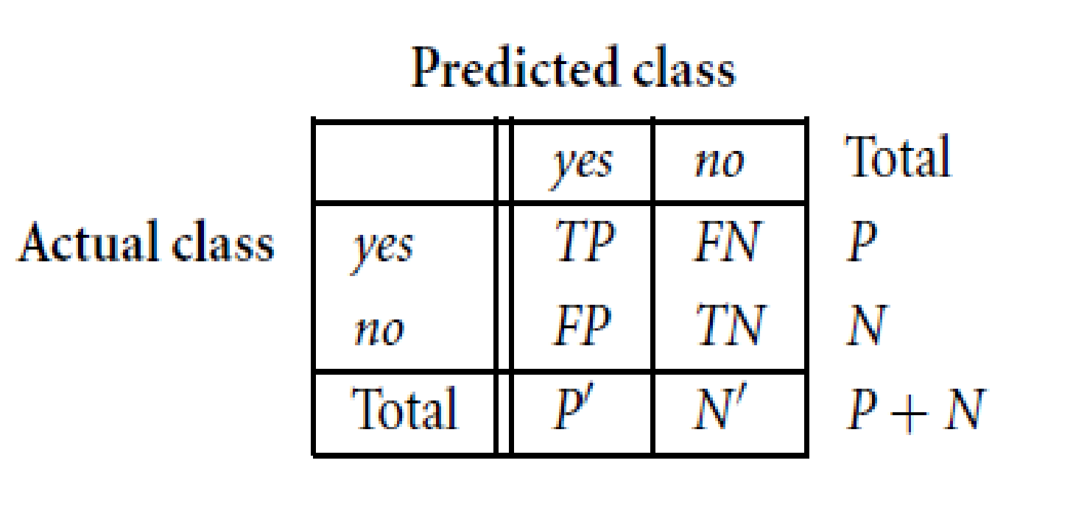
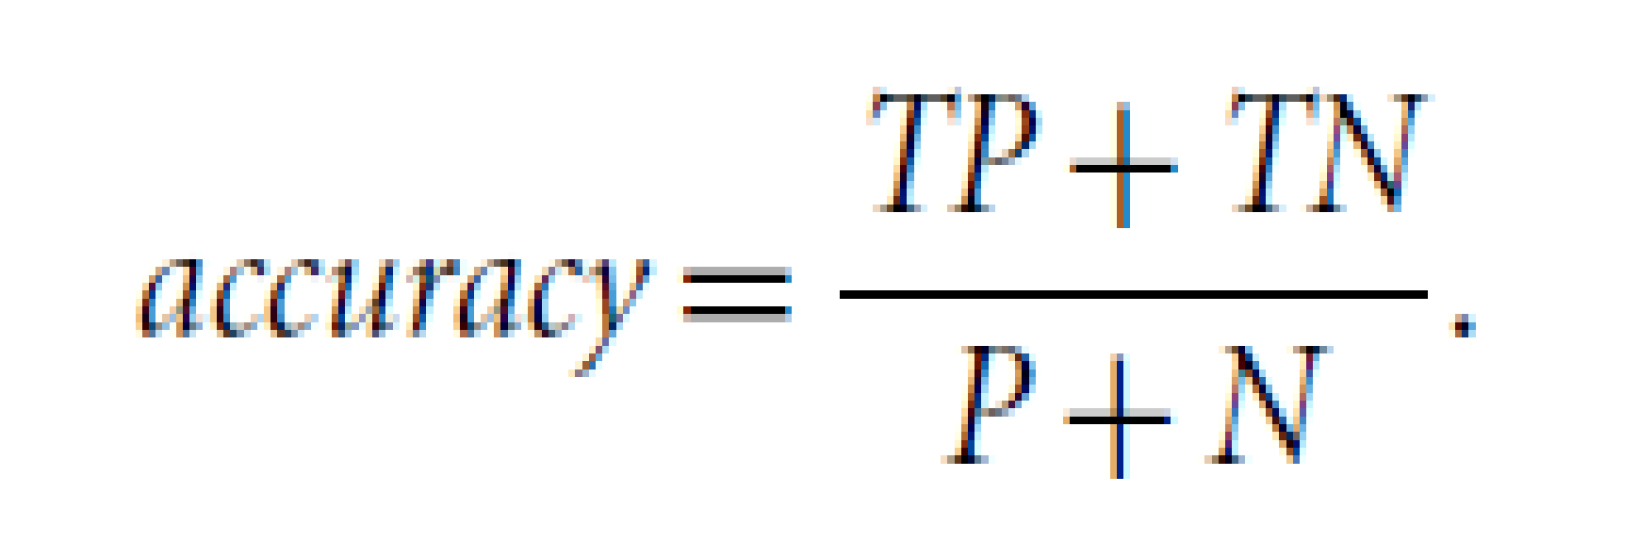
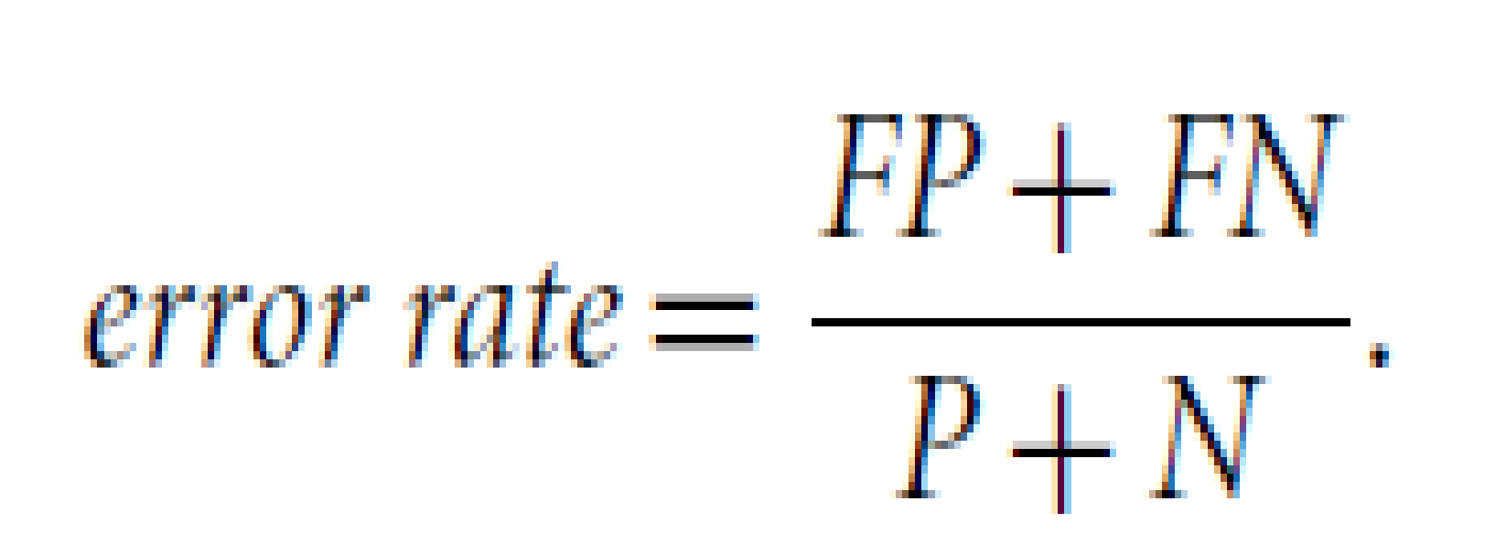
Metrics for Evaluating Classifier Performance
Confusion Matrix (CM): The confusion matrix is a useful tool for analyzing how well your classifier can recognize tuples of different classes.
Given m classes, CM_{i,j}, an entry in a confusion matrix, indicates # of tuples in class i that are labeled by the classifier as class j
‹#›

Slide 4
Metrics for Evaluating Classifier Performance
classes | buy_computer = yes | buy_computer = no | total | recognition(%)
buy_computer = yes | 6954 | 46 | 7000 | 99.34
buy_computer = no | 412 | 2588 | 3000 | 86.27
total | 7366 | 2634 | 10000 | 95.52
Accuracy of a classifier M, acc(M): percentage of test set tuples that are correctly classified by the model
Error rate (misclassification rate) of M = 1 – acc(M)
‹#›

Slide 5
Class Imbalance Problem
The main class of interest is rare. That is, the data set distribution reflects a significant majority of the negative class and a minority positive class.
For example, in fraud detection applications, the class of interest (or positive class) is “fraud,” which occurs much less frequently than the negative “nonfraudulant” class.
In medical data, there may be a rare class, such as “cancer.”
Suppose that you have trained a classifier to classify medical data tuples, where the class label attribute is “cancer” and the possible class values are “yes” and “no.”
An accuracy rate of, say, 97% may make the classifier seem quite accurate, but what if only, say, 3% of the training tuples are actually cancer? Clearly, an accuracy rate of 97% may not be acceptable—the classifier could be correctly labeling only the noncancer tuples, for instance, and misclassifying all the cancer tuples. Instead, we need other measures, which assessess how well the classifier can recognize the positive tuples (cancer = yes) and how well it can recognize the negative tuples (cancer = no).

Slide 6
Class Imbalance Problem
The main class of interest is rare.
e.g In medical data, there may be a rare class, such as “cancer.”
For Class Imbalance problems , we need other measures, which assesses how well the classifier can recognize the positive tuples (e.g. cancer = yes) and how well it can recognize the negative tuples (e.g. cancer = no).

Slide 7
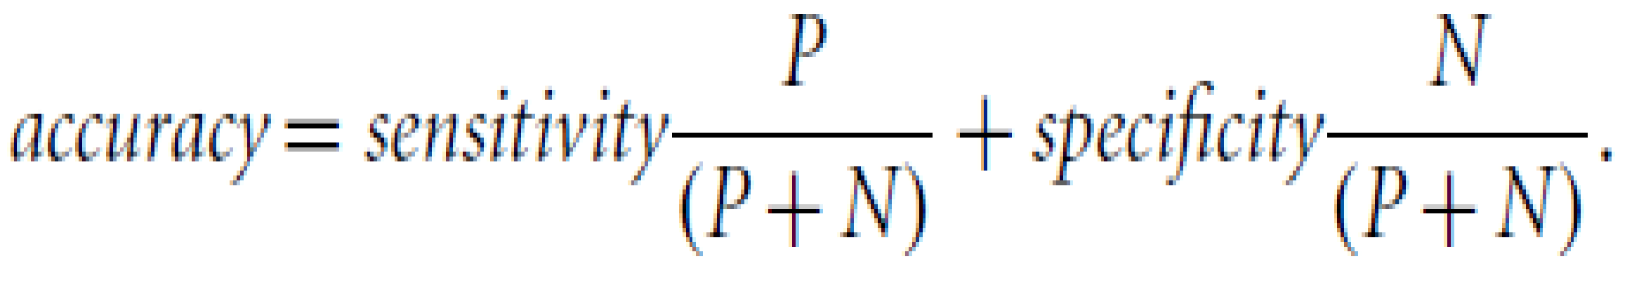
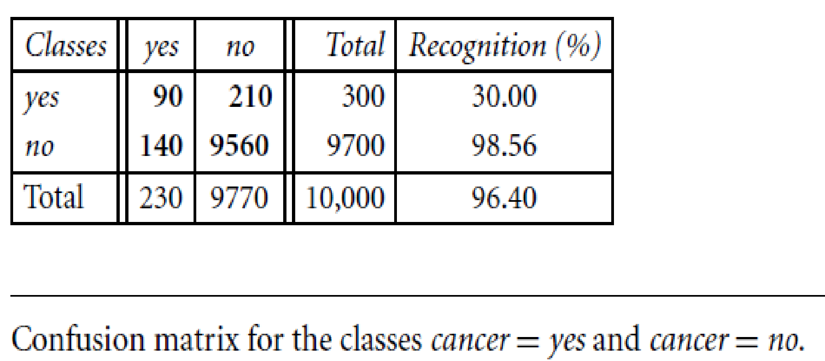
Alternative Accuracy Measures: Sensitivity and Specificity
Sensitivity = True Positive Rate(TPR) = TP/P
/* true positive recognition rate:(i.e., the proportion of positive tuples that are correctly identified) */
Specificity = True Negative Rate(TNR) = TN/N
/* true negative recognition rate .(the proportion of negative tuples that are correctly identified*/
Example:
The sensitivity of the classifier is 90 / 300 = 30.00%.
The specificity is 9560 / 9700 = 98.56%.
The classifier’s overall accuracy is 9650 / 10,000 = 96.50%.
‹#›
Notes:
‹#›

Slide 8
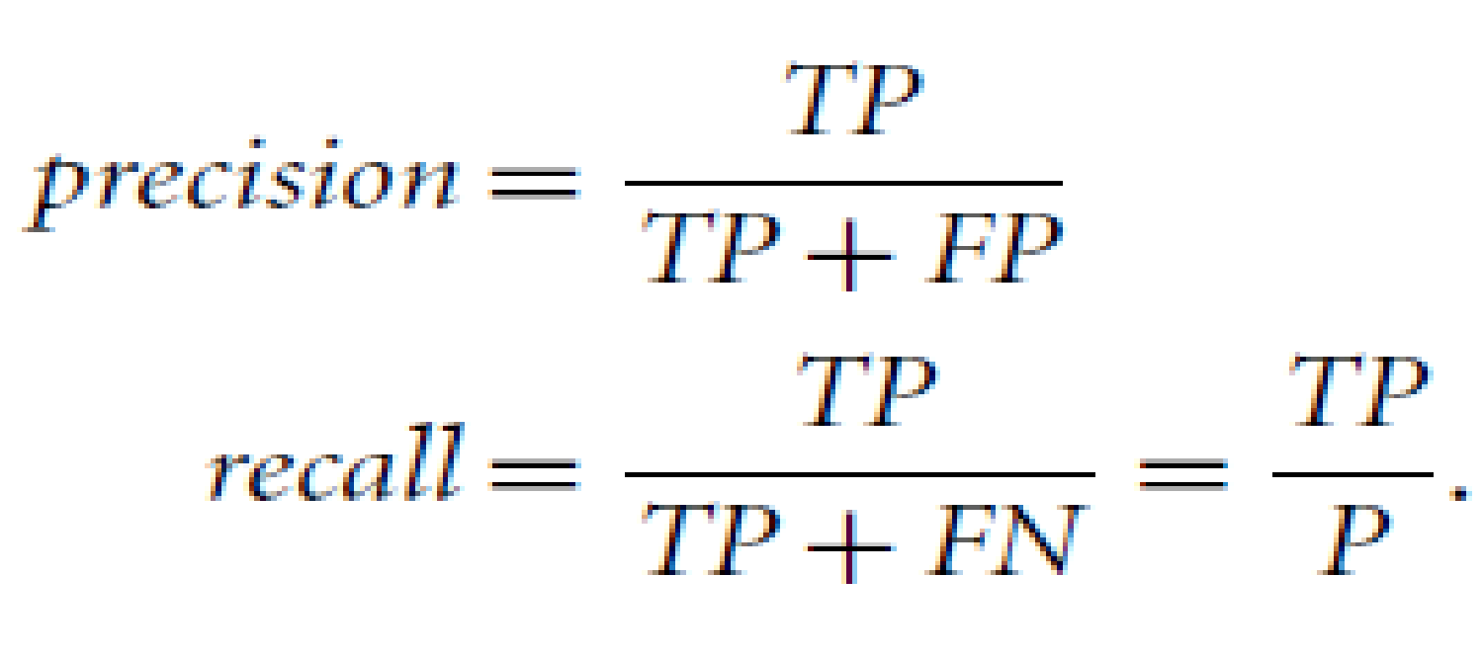
Metrics for Evaluating Classifier Performance
Precision and Recall
Precision is a measure of exactness (i.e., what percentage of tuples
labeled / predicted as positive are actually such),
Recall is a measure of completeness (what percentage of positive tuples are labeled/predicted as such). It is similar to sensitivity.
Example:
The precision of the classifier in Example for the yes class is 90 / 230 = 39.13%.
The recall is 90 /300 = 30.00%, which is the same calculation for sensitivity
There tends to be an inverse relationship between precision and recall, where it is possible to increase one at the cost of reducing the other.
‹#›

Slide 9
F1- Score
F1-Measure provides a way to combine both precision and recall into a single measure that captures both properties.
We can have excellent precision with terrible recall, or alternately, terrible precision with excellent recall.
F1-measure provides a way to express both concerns with a single score which weights precision and recall equally.
Once precision and recall have been calculated for a binary or multiclass classification problem, the two scores can be combined into the calculation of the F-Measure.
F1-Score = (2 * Precision * Recall) / (Precision + Recall)
The F1-score is the variant most often used when learning from imbalanced data.

Slide 10
Precision and Recall
A perfect precision score of 1.0 for a class C means that every tuple that the classifier labeled as belonging to class C does indeed belong to class C. However, it does not tell us anything about the number of class C tuples that the classifier mislabeled.
A perfect recall score of 1.0 for C means that every item from class C was labeled as such, but it does not tell us how many other tuples were incorrectly labeled as belonging to class C.
There tends to be an inverse relationship between precision and recall, where it is possible to increase one at the cost of reducing the other.
Precision and recall scores are typically used together, where precision values are compared for a fixed value of recall, or vice versa. For example, we may compare precision values at a recall value of, say, 0.75.
‹#›

Slide 11
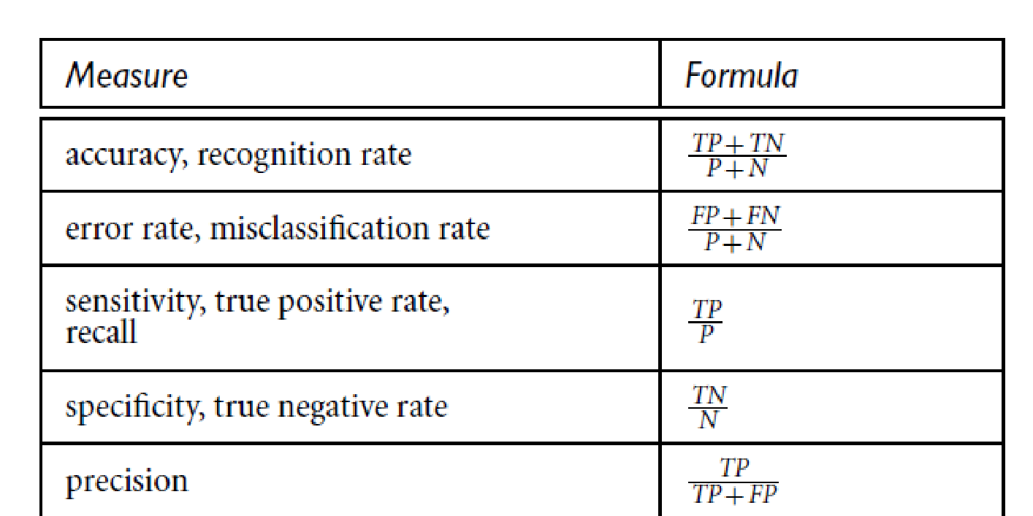
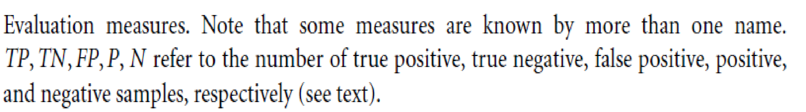
Metrics for Evaluating Classifier Performance
The accuracy measure works best when the data classes are fairly evenly distributed. Other measures, such as sensitivity (or recall), specificity, precision, F, and F, are better suited to the class imbalance problem, where the main class of interest is rare.
‹#›

Slide 12
Other classifier evaluation aspects
In addition to accuracy-based measures, classifiers can also be compared with respect to the following additional aspects:
Speed: This refers to the computational costs involved in generating and using the given classifier.
Robustness: This is the ability of the classifier to make correct predictions given noisy data or data with missing values.
Scalability: This refers to the ability to construct the classifier efficiently for the given large amount of data.
Interpretability: This refers to the level of understanding and insight that is provided by the classifier or predictor.
‹#›

Slide 13
In addition to accuracy-based measures, classifiers can also be compared with respect to the following additional aspects:
Speed: This refers to the computational costs involved in generating and using the given classifier.
Robustness: This is the ability of the classifier to make correct predictions given noisy data or data with missing values. Robustness is typically assessed with a series of synthetic data sets representing increasing degrees of noise and missing values.
Scalability: This refers to the ability to construct the classifier efficiently given large amounts of data. Scalability is typically assessed with a series of data sets of increasing size.
Interpretability: This refers to the level of understanding and insight that is provided by the classifier or predictor. Interpretability is subjective and therefore more difficult to assess. Decision trees and classification rules can be easy to interpret, yet their interpretability may diminish the more they become complex.
‹#›

Slide 14
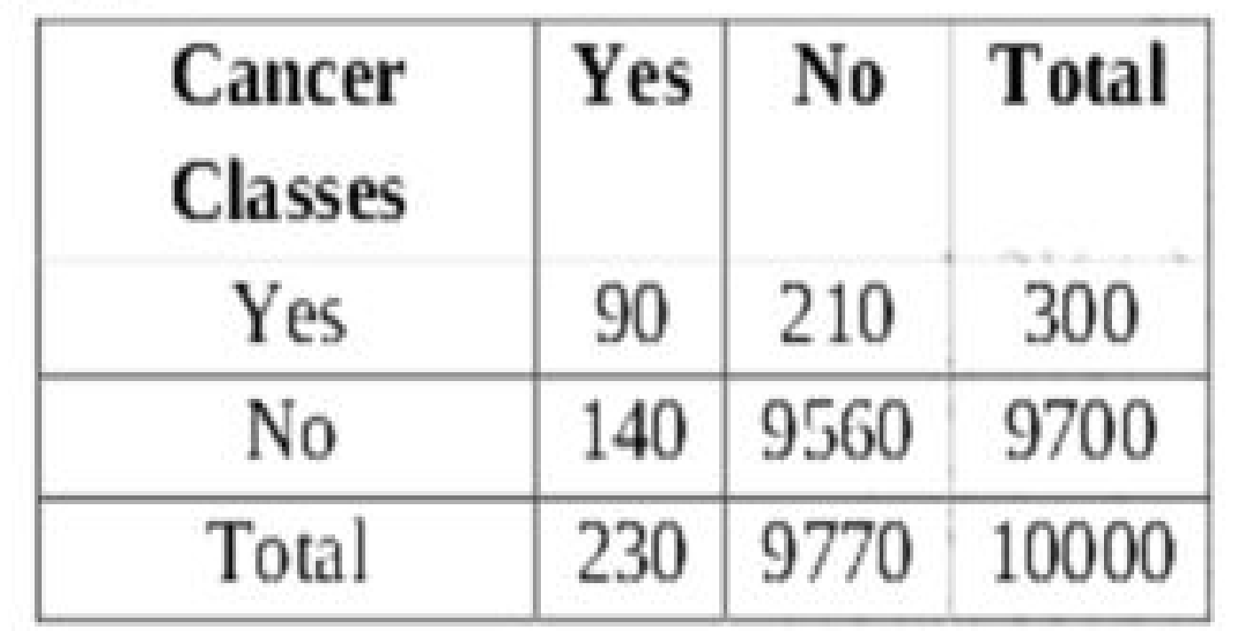
Calculate Accuracy, Precision and Recall for following confusion matrix
‹#›

Slide 15
Measure | Important when | Used when
Accuracy | you have symmetric datasets (FN & FP counts are close) | false negatives & false positives have similar costs.
Sensitivity/Recall | identifying the positives is crucial. | the occurrence of false negatives is unacceptable/intolerable. You’d rather have some extra false positives (false alarms) over saving some false negatives. For example, when predicting financial default or a deadly disease.
Precision | you want to be more confident of your predicted positives. | the occurrence of false positives is unacceptable/intolerable. For example, Spam emails. You’d rather have some spam emails in your inbox than miss out some regular emails that were incorrectly sent to your spam box.
Specificity | you want to cover all true negatives. | you don’t want to raise false alarms. For example, you’re running a drug test in which all people who test positive will immediately go to jail.

Slide 16
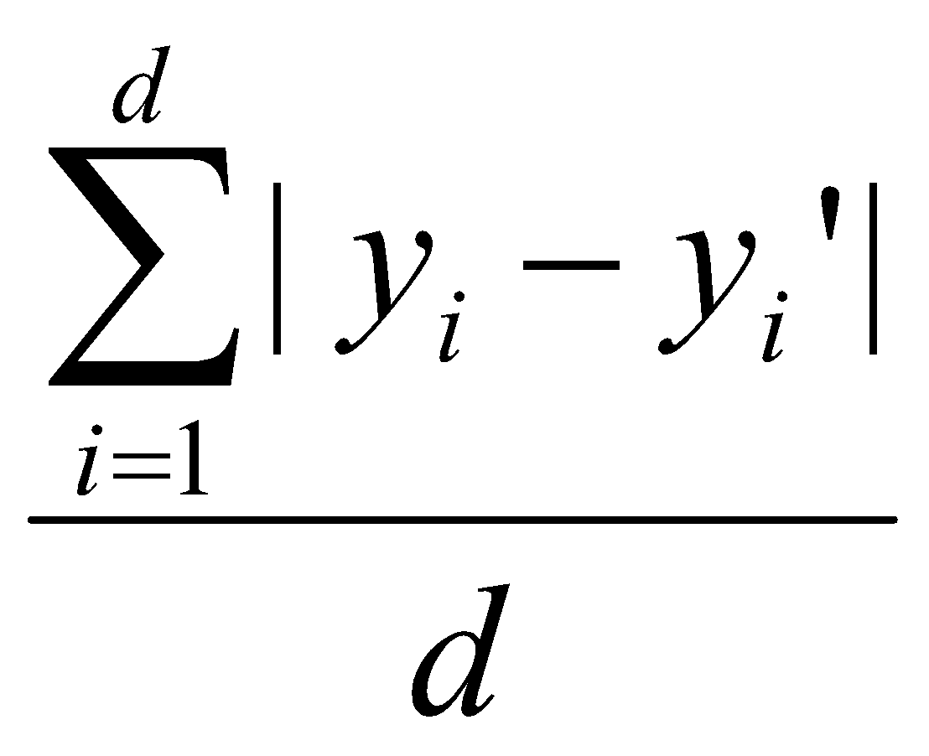
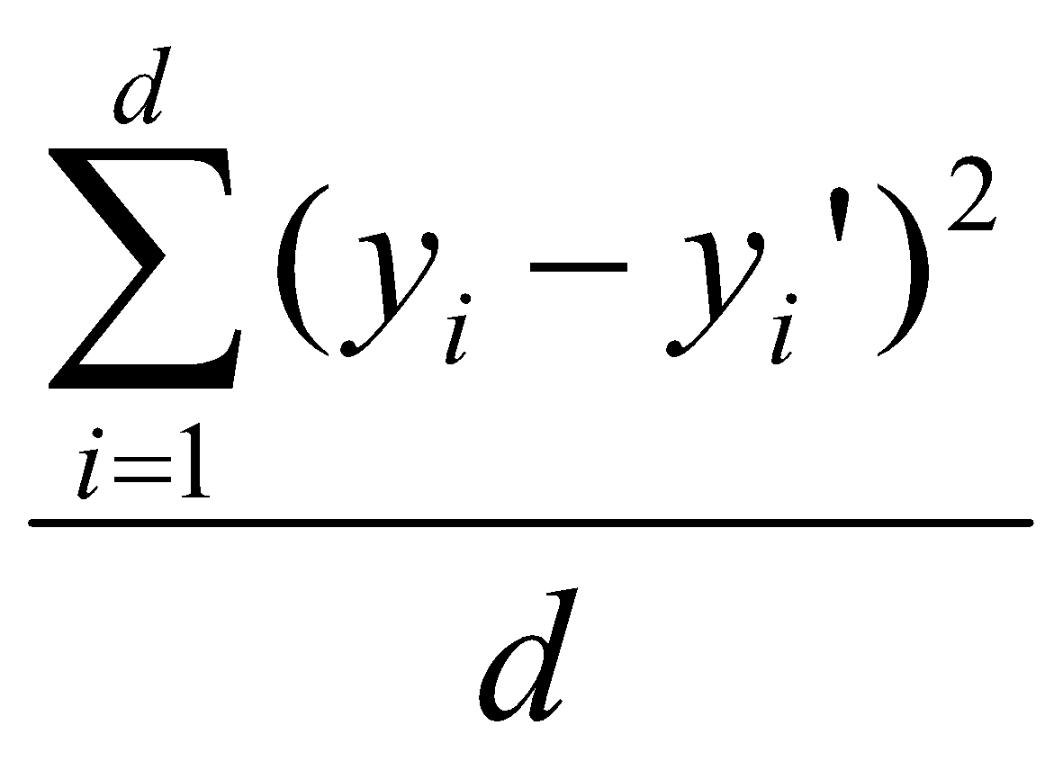
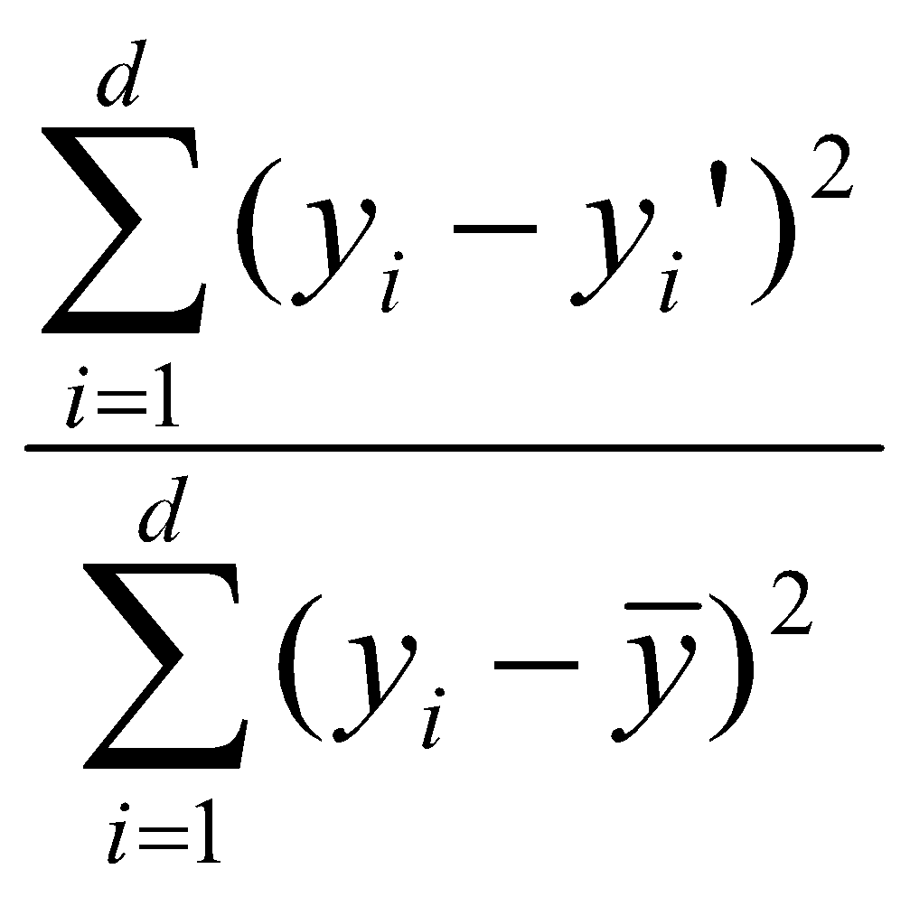
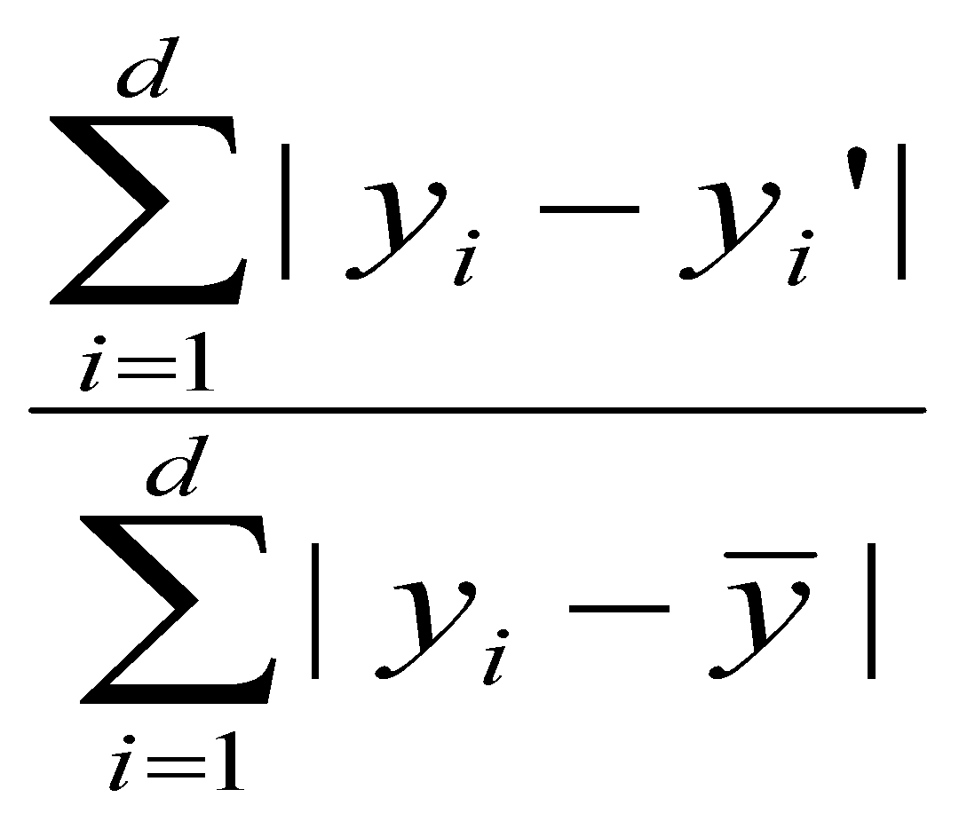
Predictor Error Measures
Measure predictor accuracy: measure how far off the predicted value is from the actual known value
Loss function: measures the error betw. y_{i} and the predicted value y_{i}’
Absolute error: | y_{i} – y_{i}’|
Squared error: (y_{i} – y_{i}’)²
Test error (generalization error): the average loss over the test set
Mean absolute error: Mean squared error:
Relative absolute error: Relative squared error:
The mean squared-error exaggerates the presence of outliers
Popularly use (square) root mean-square error, similarly, root relative squared error
‹#›
Notes:
‹#›

